Slide 1
2022 survey of applications
Laurent Gouzenes,
KM2 Conseil
Knowledge Management 2nd generation
Available here :
https://www.km2-conseil.fr//PROLOG/DOCS/APPLICATIONS/NEW_APPLICATIONS/PROCESSING%20NEW%20APPLICATIONS%20IN%20PROLOG.htm

Slide 2
Why a survey ?
Update of the 1995 survey
Need to understand the practical applications
Identify strengths and weaknesses
Identify opportunities
Dissemination of useful knowledge

Slide 3
Methodology : General process
1995
2022
Raw xml format
(13667 lines)
Census form
Cleanup
Json files
Json files
{ « keyword » : « value », * }
ANALYSIS TOOL
ANALYSIS TOOL
python
1995 survey HTM FILE
2022 survey HTM FILE
Python, html, javascript
2022 this synthesis
Available here : https://www.km2-conseil.fr//PROLOG/DOCS/APPLICATIONS/VIEILLES_APPLICATIONS/PROCESSING%20OLD%20APPLICATIONS%20IN%20PROLOG.htm

Slide 4
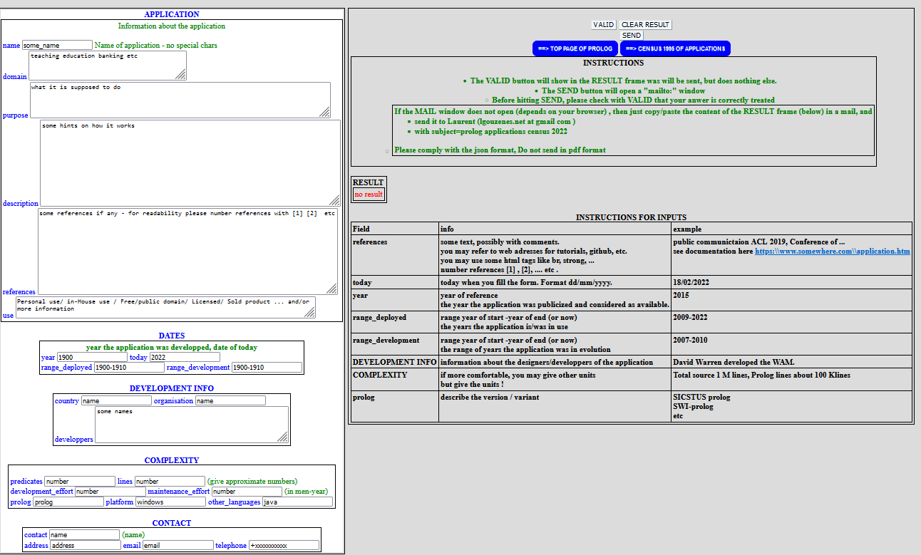
Methodology : census form
Same census form 1995/2022
Census form

Slide 5
FIRST RESULTS
BUT
BIAS ?
was the survey not efficient enough / too early at this stage ?
-Mostly educational sources
Are all dialects of prolog, and notably extensions, really considered ?
Application based on extensions of Prolog not all received.
Many applications rely on tools written in Prolog
Prolog as a best kept secret for some companies ?

Slide 6
Size of applications
Follow a classical exponential pattern
20% are large or very large applications > 100 k lines
2 applications above 1 Million lines :
- Alpino : dutch generator
- PROSYN : expert system in chemical indusytry
50% are < 10 k lines

Slide 7
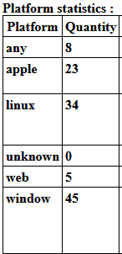
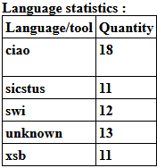
Variants of prolog and platforms used

Slide 8
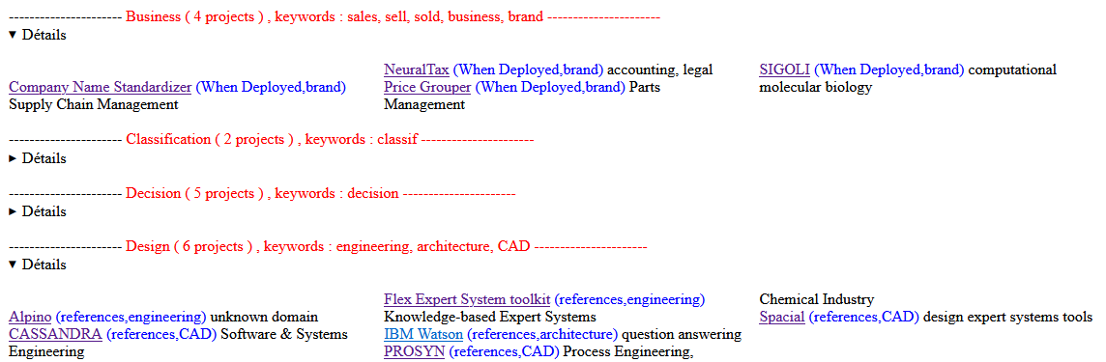
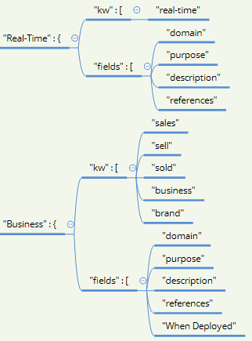
Application by domains
Domains are defined by some keywords that must be present in the description, references, etc
Result :

Slide 9
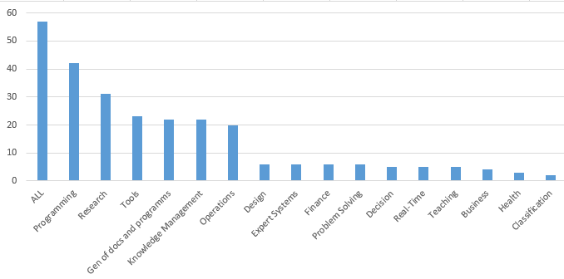

Application by domains
2022

Slide 10
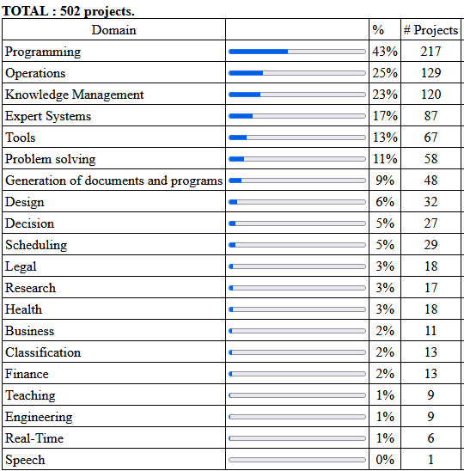
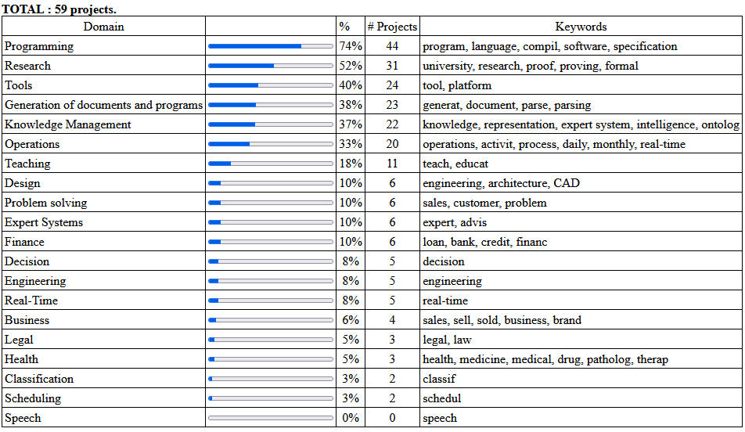
Comparing the spectrums of applications
1995
2022
Progression of research
Bias ?
Applications in 2022 seem to have a wider scope

Slide 11
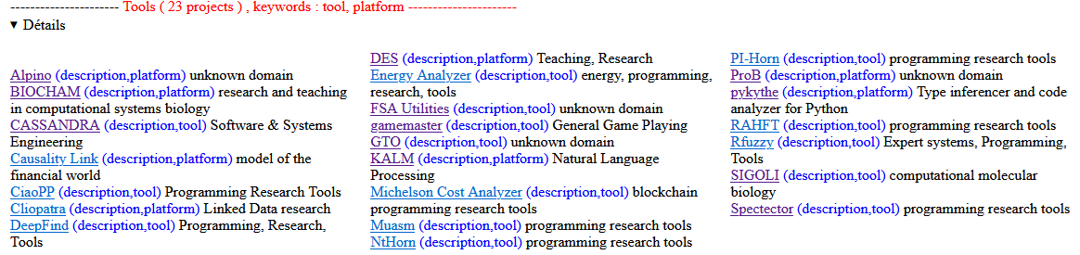
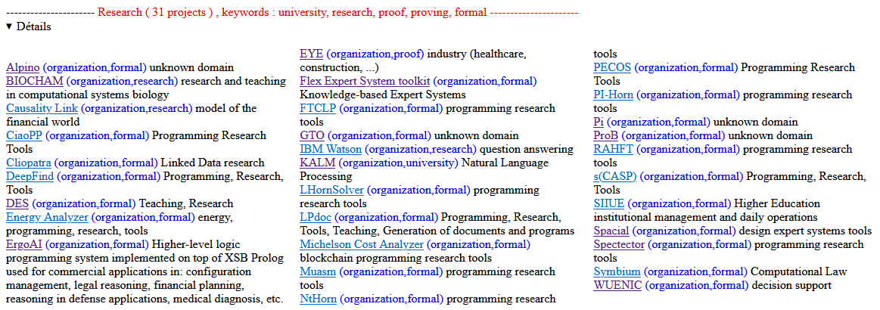
Prolog used widely for tools and research

Slide 12
Conclusions
After the hype and fall phase of the 80's and 90's, Prolog use and popularity of Prolog seems stable, even slightly up, despite so many new 'hot' languages.
Prolog still used to solve hard problems
  Used a lot in research
  Great and difficult applications use Prolog at key points
  Use of Tools of higher level for applications
  Still used for AI ????
Challenges :
  Competing with other mainstream languages :
    Many versions, libraries, gits, etc
    Development tools ?
  Prototype version in Prolog ➔ final in another language(speed ? Maintenance ?)
  Great applications ?

Slide 13
BACKUP

Slide 14
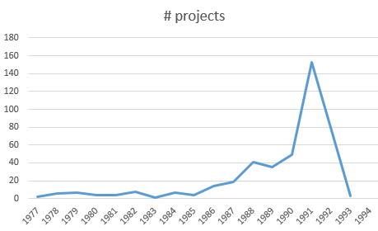
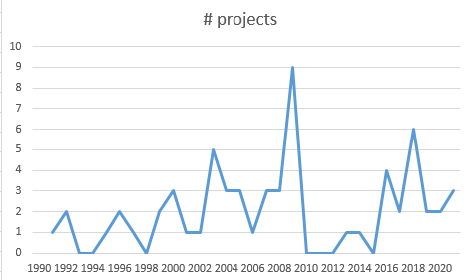
Applications by age
1995
2022
Scale / 10
18 years
30 years

Slide 15
Applications 2022 by domains
Bias ?

